Slide 1


Slide 2
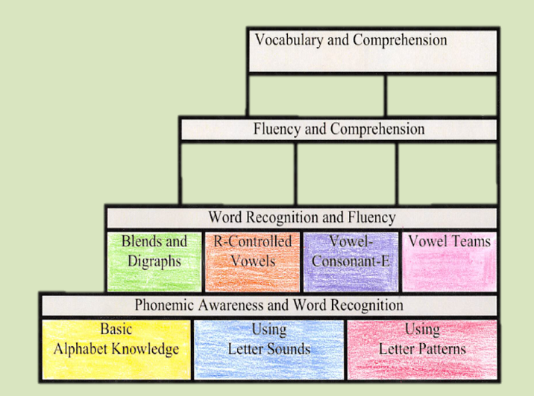
I Can….
End of Year Goals
Reading DI: Vocabulary and Comprehension
Fluency: 100 wcpm
Lexile: 520 – 820
  670L is midpoint
Fluently multiply one-digit numbers: 80% accuracy
Bookworms intensive, UFLI

Slide 3
Communication
Mrs. Brackett
kbrackett@paulding.k12.ga.us
Mrs. Bigler
cbigler@paulding.k12.ga.us
Mrs. Hobbs
whobbs@paulding.k12.ga.us
Mrs. Magardo
jmagardo@paulding.k12.ga.us
Mrs. Grant
Kelliew.grant82@paulding.k12.ga.us
Dojo
Email
Remind
Talking Points

Slide 4
Binders
The first week of school, we set up your child’s binder for a successful year. In the binder you will find a monthly calendar, the weekly newsletter, the specials schedule, as well as some helpful math strategies.
We try to remind the students to keep their binders neat and organized.
Throughout the week, please make sure your child has cleaned out his/her binder of any loose papers. This will help to keep them clean and organized.

Slide 5



Word Study
We are all used to the traditional spelling list and memorizing spelling words. Guess what happens 2 weeks later when students need to use one of those words in their writing?- they’ve forgotten how to spell it. It is for this primary reason that we focus on chunking words into syllables and spelling one syllable at a time using the strategies that we use and discuss daily. According to the authors of our Bookworms Literacy Curriculum, “Chunking words into syllables is an aid in decoding, spelling, and meaning. Multisyllabic word study words can be analyzed at the syllable level. The goal of this instruction is to build flexible strategies for attacking unknown words.” So, to help you understand a little better, here is the process that we use in order to spell an unknown word.

Slide 6
Weekly Homework
Most weeks, your child will receive weekly math fluency homework that consists of practice problems reviewing current/past math standards. This math worksheet is due every Friday. It is VERY important that the students attempt the homework. We will go over some of the problems in class if we feel like students are struggling with the problems. The math homework can be found on the back of the weekly newsletter.
Every Monday, there will be a newsletter, which can be found in your child's binder (hopefully). On this newsletter you will find important dates, events, information, as well as the weekly standards and subject content.

Slide 7
Wednesday Take Home Folder
Every Wednesday, your child will be sent home with a blue folder. In this folder, you will find your child’s work from the week, as well as important notes/flyers.
Please make sure you look at all the papers in the folder, take them out, and sign on the line next to the correct date. This lets me know you have seen your child’s work and the important papers.

Slide 8

Snacks/Birthday Celebrations
We do have a snack time. We call it a “working snack.” . Please make sure you child is bringing a healthy snack. No candy.
If you would like to donate snacks to the class, you may do so. It works best if they are individually wrapped snacks. Remember, only store-bought items are allowed. No homemade goodies. Please try to refrain from snacks with peanuts because we are a “peanut free” classroom.
For birthdays, your child may bring in a treat to share with the entire class. This may include, cupcakes, cookies, etc. Remember, only store bought please. The Cafeteria is also selling birthday treats. They have cookies for $.50 or ice cream for $1.00. Please contact the cafeteria if you would like to do this.
Please ONLY water. Your child may bring a water bottle every day if that is what he/she wants to do.

Slide 9

Transportation/Check Outs
If your child will be going home a different way than usual, please send in a signed note letting me know of the change. Please include the dates and a phone number you can be reached at if there are any questions.
We CANNOT accept emails for a transportation change. Please contact the office if you have a change that needs to be made last minute. Remember changes need to be made by 1:30.
The school is a 100% ID check. Please have it ready before you are allowed in the building. There are no check outs after 1:30.

Slide 10
Absences/Lunchroom
Please make sure your child is on time to school. This is a very critical year and we do not want your child to miss anything.
If your child is absent, please make sure you write a note explaining the reason for your child’s absence.
Lunchroom News:
PLEASE make sure your child has money in his/her account. Your child can only charge 3 times before they are given an alternative lunch. If your child is getting extras, please be aware of this.
We do our best to notify you when your child is low. If you have any concerns, please let us know so we can get them taken care of.
Breakfast is $1.40 and lunch is $2.15
PLEASE make sure you redo your applications for SY 24-25. The Free Lunch Grant has ended.

Slide 11
Digital Learning Days
Digital Learning Days are no longer optional. Students who do not have access to a working device at home will be expected to notify the teacher prior to DLD. The teacher will give them a packet comparable to the canvas assignments.
Students have 5 days to complete the work.
Student names of those who do not complete the assignments will be sent to Admin and will be marked absent for that day.

Slide 12

Assessments
In third grade, students will take the Reading Beacon and the Math Beacon. We take this assessment to show student growth.
In April, we will be taking the Georgia Milestones Assessment. Third Grade students will take the Reading/ELA portion, as well as the Math portion of this test. Students in third grade are required to pass the Reading/ELA portion of the GMA to move onto the fourth grade. Move information to come later.

Slide 13
Any questions?

Slide 14
QUIZ TIME!!!!
Question #1
True or False: I come up to the school everyday. I do not need my ID. The office people know me.

Slide 15
Question #2
True or False
Digital Learning Days count for attendance and completed this year.

Slide 16
Question #3
How often will your child have a syllable coding assessment?
a. Every week
b. Every 2 weeks
c. Once a month

Slide 17
Question #4
True or False?: You do not need to sign the Wednesday Take Home Folders.

Slide 18
Question #5
Ms. Sally Sue wants to bring in homemade cupcakes for Johnny’s birthday. Is this allowed? Yes or No.

Slide 19
Question #6
True or False? We cannot accept emails as a transportation change notice.

Slide 20
Question #7
What state test will your child take in April?

Slide 21
Question #8
What is an example of an inappropriate snack?
a. M&M’s
b. Peanut Butter Crackers
c. Goldfish

Slide 22
Question #9
Name 2 ways you can contact your child’s teachers?

Slide 23
Question #10
Where can the math fluency homework be found?

